Slide 1
Integrated Coastal Zone Management
Unit 1: Governing Coastal Ecosystems

Slide 2
Introduction
Unit content
Coastal ecosystems
Services provided by coastal ecosystems: renewable and non-renewable resources
Responsibility for managing coastal ecosystems
Conflict and management
Learning outcomes
Upon completion of this unit, students will be able to
Understand the concept of coastal ecosystems
Appreciate the need to manage non-renewable resources
Understand the complexity of governing coastal ecosystems

Slide 3
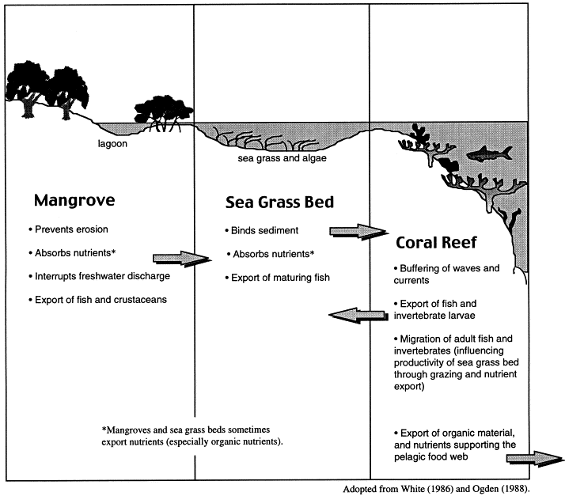
Tropical coastal ecosystems

Slide 4
Coastal ecosystem services

Slide 5
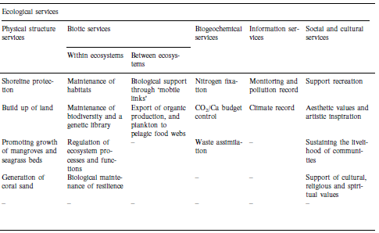
Coastal ecosystem services
✓
✓
✓
✓
✓
✓
✓
✓
✓
✓
✓
✓
✓
✓
✓
✓ Important to local user groups

Slide 6
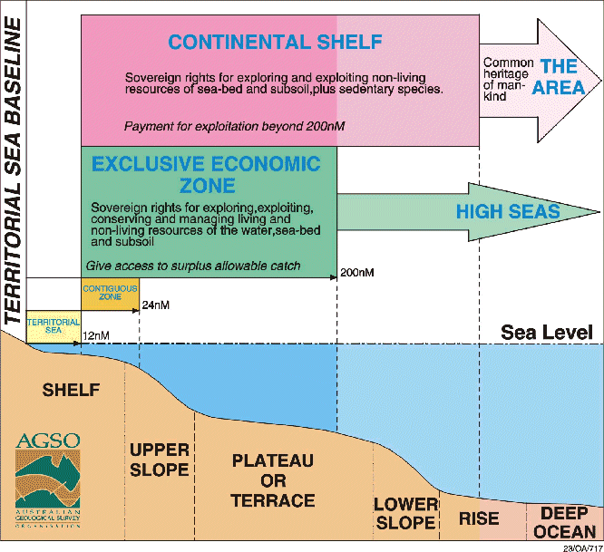
Coastal government
Different government institutions are responsible for marine and coastal areas
Some areas (high seas) may be under no government
Inshore areas may be under more than one level of government (district, province etc)
Conflict and uncertainty over responsibility for coastal management is commonplace

